Slide 1

Automated Tagging of Articles
Nikita Jayakar (nmj303)
Rochak Agrawal (ra3117)
Ghanashyam Tatti (gvt217)

Slide 2




The need for Automated Tagging
Constant influx of articles
Manually tagging each article is a difficult and time consuming process
Tags/Keywords are crucial data for search engines
Tagging helps improve recommendations

Slide 3




What this project aims to do
CONSUME APIS TO FETCH ARTICLES
EXTRACT METADATA
(TAGS AND SENTIMENT)
SENTIMENT PROVIDES AN OVERALL OPINION CONVEYED
INDEX METADATA TO PROVIDE IMPROVED SEARCH

Slide 4

Why does this qualify as a Big Data project
Velocity
Volume
Approximately 5.8 million new blog posts are created every day
Over 3.2 million news articles are published every day
Today, there are more than 512 million blogs

Slide 5






Tech Stack

Slide 6
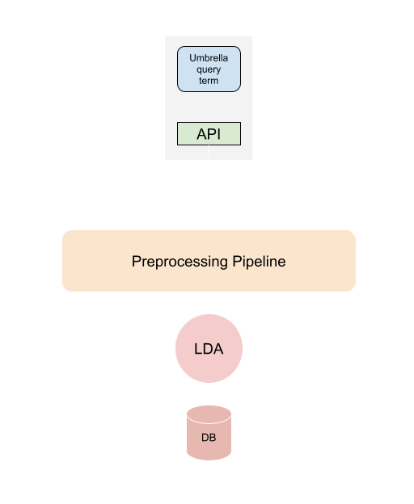
System Design

Slide 7
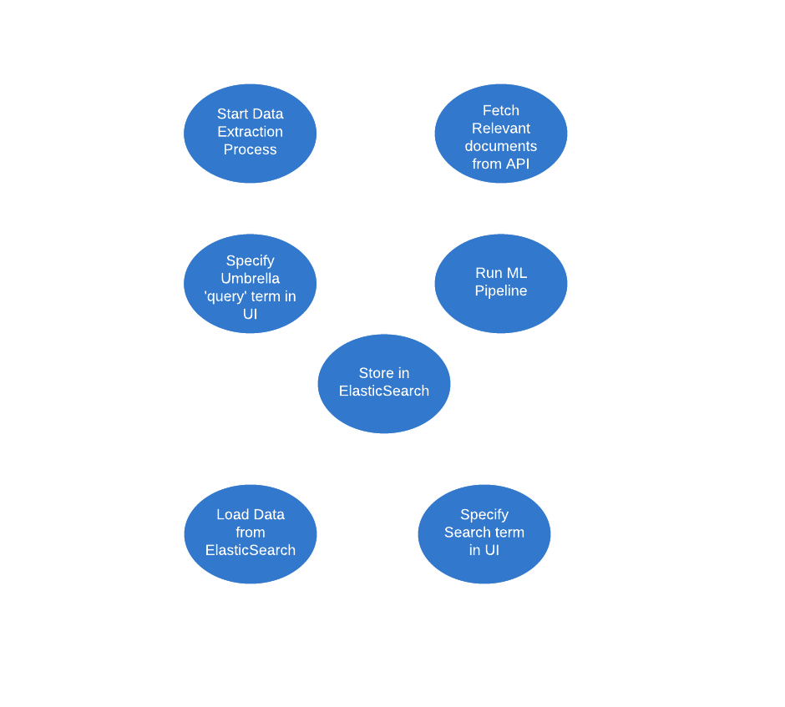
Use Case

Slide 8
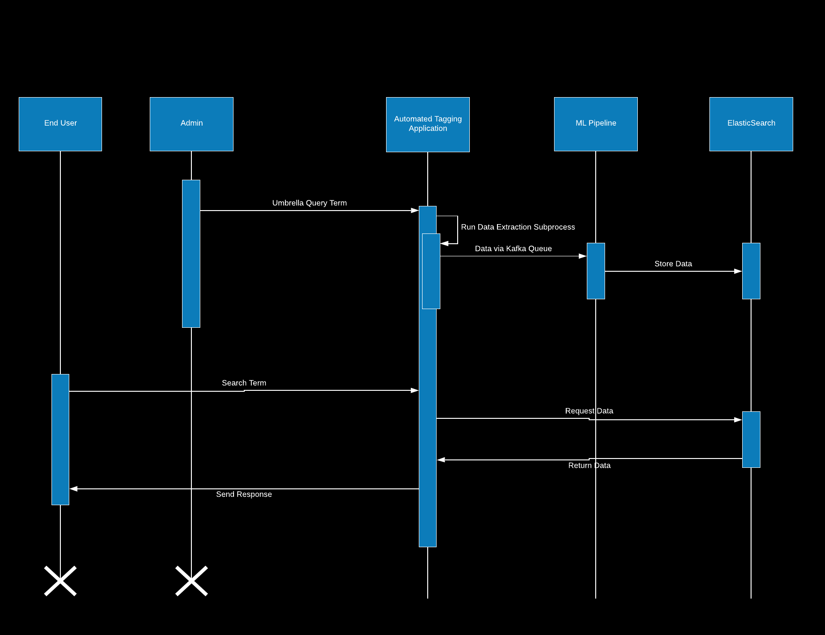
Sequence Diagram

Slide 9
Demo

Slide 10
Thank you

